Slide 1
CTE Model Curriculum Standards Implementation
Home Economics Careers & Technology Education
(HECT)
“CTE Leading the Way Towards Career AND College Readiness”
Notes:
Welcome audience
Quick survey of who the audience is (Teachers, Site Administrators, Counselors, COE or District Superintendents)
Acknowledge any CDE staff in room and any members of the CCSESA CTE Workgroup

Slide 2
Target Outcomes
Upon completing this session, you will understand:
Major new features in CTE standards related to HECT
Utilize the CFS Implementation Resource Guide
HECT Integration with Common Core State Standards and Standards for Career Ready Practice
Notes:
Slide is self explanatory.

Slide 3
Major New Features in CTE Standards

Slide 4
New Model CTE Standards
Fewer, clearer, deeper
Research and evidence based
Reasonable in scope
Essential, rigorous, clear, specific and
coherent
Aligned with postsecondary and work
expectations
Measurable
Notes:
When the state board adopted the common core state standards, the need arose to align the CTE standards with the new common core. Therefore, the new model CTE standards were developed with deliberate parallels to Common Core State Standards. The Standards become your daily TARGETS. The “To Do” words are in the standards. There is no need to rewrite objectives & Standards to get the objective of the lessons across.
Say something like, “The new standards are fewer clearer and deeper similar to common core, based on research, and aligned with postsecondary and work expectations. They are measurable because college and career readiness demands that career readiness be measured.”

Slide 5
HECT Standards Found in 3 Industry Sectors
Education, Child Development, & Family Services
Fashion and Interior Design
Hospitality, Tourism, & Recreation
Notes:
Again the three (3) Industry sectors in which HECT standards are found are Education, Child Development, Family Services, Fashion and Interior Design, and Hospitality, Tourism, and Recreation

Slide 6
HECT Standards Developed for
Consumer & Family Studies (CFS)
Grades 7-12
Home Economics Related Occupations (HERO)
Grades 10-12
Notes:
The HECT Standards were developed for both Consumer & Family Studies (CFS)- Grades 7-12 and Home Economics Related Occupations (HERO) – Grades 11-12

Slide 7
Two (2) types of Standards in CTE Document
Anchor – 11 per Sector
Career Pathway 1-7 different pathways per sector
Notes:
When you look in the CTE Standards document you will find two types of Standards : Anchor – 11 per sector and Career Pathway with1-7 pathways per sector. As we look more closely all this becomes more clear.

Slide 8
ANCHOR STANDARDS
Academics(Refer to the Academic Alignment Matrix).
Communications (Direct alignment with LS 9-10, 11-12.6)
Career Planning and Management
Technology
Problem Solving and Critical Thinking
Health and Safety
Responsibility and Flexibility
Ethics and Legal Responsibilities
Leadership and Teamwork (FHA-HERO)
Technical Knowledge and Skills (CFS in HECT Sectors only)
Demonstration and Application
Notes:
Let’s look first at the Anchor Standards which are the same for all 15 Industry Sectors. Look in your turquoise standards book, this replaces the old blue book. Turn to page 6. The first is Academics and includes the Common Core standards. Turn to page 9 to see a sample of the Academic Alignment Matrix . We have done the hard work for you by aligning the CTE Pathway standards to the Common Core in an academic matrix at the end of each industry sector. (Read for example on page 9) Anchor Standard 2 is Communication and there is a direct alignment with this standard to the common core LS 9-10, 11-12.6.
The third anchor standard is Career Planning and Management, 4.0 Technology, 5.0 Problem Solving and Critical Thinking, 6.0 Health and Safety, 7.0 Responsibility and Flexibility and 8.0 Ethics and Legal Responsibilities
9.0 Leadership and Teamwork ; FHA-HER0 is our showcase for program promotion and 10.0 Technical Knowledge and Skills which varies from sector to sector and is where we find CFS in HECT Sectors only). The final anchor standard 11.0 is Demonstration and Application.
Remember, every industry sector has 11 anchor standards and you will find CFS standards in Anchor Standard #10, while the HERO Standards are found in the CTE Career Pathway Standards.

Slide 9
HECT Industry Sectors
3 Industry Sectors
7 CFS Content Areas
9 HERO Career Pathways
Notes:
Again there are 3 HECT industry sectors which contain 9 HERO Career Pathways based on instruction from the 7 CFS Content Areas

Slide 10
CFS Programs:
First course in the sequence of articulated instruction
Includes exploratory, introductory, and concentration courses
Supported by district or Perkins funds
Taught by teachers with a CA credential or equivalent in Home Economics Careers & Technology Education
Notes:
Consumer and Family Studies Programs are the first course in the sequence of articulated instruction. They include exploratory, introductory, and concentration courses. They are supported by district and/or Perkins funds, and are taught by teachers with a CA credential or equivalent in HECT Education.
How many of you teach one or more CFS courses?

Slide 11
Consumer and Family Studies (CFS) instructors would address:
Anchor Standards #1 – 11
CFS #10 Technical Knowledge
and Skills = CFS
Note: CFS teachers would not teach the career path standards unless qualified with related industry experience
Notes:
If you are teaching Consumer and Family Studies courses and are a CFS instructor you would address: the Anchor Standards #1-11 and CFS #10 Technical Knowledge and Skills. Note: CFS teachers would not teach the career path standards unless qualified with related industry experience.

Slide 12
CFS Standards: Found in Anchor Standard #10 HERO Standards: Found in Career Pathway Standards
Notes:
The Consumer & Family Studies Standards are based on previous standards and include the following 7content areas: Child Development & Guidance, Consumer Education, Family& Human Development, Fashion, Textiles & Apparel, Foods & Nutrition, Housing & Furnishing and Individual & Family Health
The HERO Standards to be taught in Capstone Courses are reflected in the 9 HECT Career Pathways.
The career pathways consist of Child Development; Consumer Services; Education, Family and Human Services; Fashion Design and Merchandising; Interior Design; Food Science, Dietetics, and Nutrition; Food Service and Hospitality; and HTR.
The pathway standards are not meant to be a single course, there may be more than one course needed to cover the standards.

Slide 13
About CFS Standards
Included under each HECT Industry Sector
Correspond to related Industry Sectors
Listed under Anchor Standards – #10 – Technical Knowledge & Skills
Must refer to all 3 HECT Industry Sectors to locate all CFS Standards when teaching the Comprehensive Core Course
Notes:
Now lets see what we understand about the CFS Standards. They are included under each HECT Industry Sector; Correspond to related Industry Sectors and are Listed under Anchor Standards-#10-Technical Knowledge and Skills. So you must refer to all 3 HECT Industry Sectors to locate all CFS Standards. This is important especially when teaching a life management course or the comprehensive core class. Middle grade teachers who teach an exploratory class will also need to refer to all 3 HECT Industry Sectors for all the standards.
NOTE: 10.1-10.4 common to all. This is a change from the old standards. So you will see new numbering in the CFS Implementation Guide.
Any questions or misunderstandings???

Slide 14
HERO Programs:
Career focused
Capstone Courses (11-12 grade)
Supported by district, Perkins or ROCP
Taught by teachers who have a credential and industry knowledge and experience
Notes:
HERO programs are career-focused, capstone courses. These are the course where occupational skills are taught, you also have equipment that is used in the industry in the course. They are supported by district, Perkins or ROC/P Funds and are taught by teachers who have a credential and industry knowledge and experience. When students complete the program successfully they usually are given a certificate.
Who teaches a capstone course?

Slide 15
Home Economics Related Occupations (HERO*) instructors would address:
Anchor Standards # 1 – 9 and # 11
Appropriate Career Path Standards
*Note: HERO Programs with district, Perkins, or ROCP funding
Notes:
Home Economics Related Occupation instructors would address the anchor Standards #1-9 and #11 and the appropriate Career Pathway Standards. Note: HERO Programs with district, Perkins, or ROCP funding
Note only the common to all 10.1-10.4

Slide 16
COMPOSITION OF STANDARDS
Standards Statement
Standards Subcomponents in CTE Standards only
*Exception: Anchor Standards #10 Technical Knowledge & Skills (CFS) reflects standards statements NOT subcomponents. Subcomponents are found in the CFS Implementation Guide.
Notes:
We will now look at the Composition of the Pathway Standards. First, there is a Standard’s Statement followed by Standard’s Subcomponents found only in the CTE Standards. The exception is Anchor #10 in CTE Sectors only. Anchor Standards #10 Technical Knowledge & Skills (CFS) reflects standards statements NOT subcomponents. This is important to know if your administration asks questions about teaching to the standards.
NOTE 10.1-10.4 is common to all.

Slide 17
I. Education, Child Development, and Family Services (ECDFS)
Child Development
Consumer Services
Education/Teaching
Family and Human Services
CFS – Content Areas
Family and Human Development
Consumer Education
Child Development and Guidance
Individual and Family Health
Notes:
The four career pathways found in the Education, Child Development and Family Services Industry Sector are : Child Development, Education/Teaching, Consumer Services, Family and Human Services these relate to the four CFS content areas which are Child Dev. and Guidance, Consumer Ed., Family and Human Dev., and Individual and Family Health.
(Show crosswalk, mark in the book)

Slide 18
Table of Contents Education, Child Development, and Family Services
Table of Contents………………………………………………….....0
Knowledge and Performance Anchor Standards………………..2
1.0 Academics…………………………………………….2 CFS & HERO teachers
2.0 Communications…………………………………....2 CFS & HERO teachers
3.0 Career Planning and Management……………....2 CFS & HERO teachers
4.0 Technology…………………………………………...3 CFS & HERO teachers
5.0 Problem Solving and Critical Thinking………….3 CFS & HERO teachers
6.0 Health and Safety……………………………………3 CFS & HERO teachers
7.0 Responsibility and Flexibility …………………….4 CFS & HERO teachers
8.0 Ethics and Legal Responsibilities………………..4 CFS & HERO teachers
9.0 Leadership and Teamwork………………………..5 CFS & HERO teachers
10.0 Technical Knowledge and Skills………………..5
CFS teachers 10.1-10.16 & HERO teachers 10.1-10.4 ONLY
11.0 Demonstration and Application………………..6 CFS & HERO teachers
Pathway Standards…………………………………………………....8
A. Child Development Pathway………………………………….8 HERO teachers
B. Consumer Services Pathway………………………………..13 HERO teachers
C. Education Pathway…………………………………………...17 HERO teachers
D. Family and Human Services Pathway …………………….21 HERO teachers
Academic Alignment Matrix………………………………..……...25

Slide 19
Education, Child Development, & Family Services CFS Crosswalk
Anchor Standard 10.0 Technical Knowledge & Skills
10.1-10.4 Common to All CFS and HERO Courses (NEW)
10.5-10.9 Child Development & Guidance*
10.10-10.12 Consumer Education
10.13-10.16 Family & Human Development*
10.17-10.18 Individual & Family Health*
10.19-10.21 Transferability of Knowledge & Skills
*Some standards overlap and the standard detail is different depending on the subject matter to be taught.
Notes:
ECDFS Page 5 10.1-10.4
ECDFS Page 6 10.5-10.9 CD &G see page Section 2 of CFS MS page 2, HS grade 9-12 Section 3 pg 2
ECDFS Page 6 10.10-10.12 Con Ed see page Section 2 of CFS MS page 4, HS grade 9-12 Section 3 pg 5
ECDFS Page 6 10.13-10.16 F & HD page Section 2 of CFS MS page 5, HS grade 9-12 Section 3 pg 9
ECDFS Page 6 10.17-10.18 Ind. & Family Health Section 2 CFS MS page 14, HS grade 9-12 Sect 3 pg 25
Bold taught in Comp. Core Class (Life Management)
Bold and un-bold taught in Concentration (Bold reinforced in CD or Human Dev. or Consumer Ed and the un-bold covered).

Slide 20
II. Fashion and Interior Design (FID)
Fashion Design and Merchandising
Interior Design
Personal Services (Not HECT subject matter.)
CFS – Content Areas
Fashion, Textiles and Apparel
Housing and Furnishings
Notes:
The two career pathways in the Fashion and Interior Design Industry Sector are : Fashion Design and Merchandising and Interior Design these relate to the two CFS content areas which are Fashion, Textiles and Apparel and Housing and Furnishings.
(show cross walk, mark the difference in Fashion and Interiors in the Implementation Guide)
Personal Services is for the Cosmetology, barbering, and manicure & pedicure folks. They needed a place holder and this is where management thought it best fit.

Slide 21
Table of Contents Fashion and Interior Design
Table of Contents………………………………………………….....0
Knowledge and Performance Anchor Standards………………..2
1.0 Academics…………………………………………….2 CFS & HERO teachers
2.0 Communications…………………………………....2 CFS & HERO teachers
3.0 Career Planning and Management……………....2 CFS & HERO teachers
4.0 Technology…………………………………………...3 CFS & HERO teachers
5.0 Problem Solving and Critical Thinking………….3 CFS & HERO teachers
6.0 Health and Safety……………………………………3 CFS & HERO teachers
7.0 Responsibility and Flexibility …………………….4 CFS & HERO teachers
8.0 Ethics and Legal Responsibilities………………..4 CFS & HERO teachers
9.0 Leadership and Teamwork………………………..5 CFS & HERO teachers
10.0 Technical Knowledge and Skills………………..5
CFS teachers 10.1-10.16 & HERO teachers 10.1-10.4 ONLY
11.0 Demonstration and Application………………..6 CFS & HERO teachers
Pathway Standards…………………………………………………....7
A. Fashion Design and Merchandising Pathway…………….7 HERO teachers
B. Interior Design Pathway……………………………………..11 HERO teachers
C. Personal Services Pathway…………………………………..15 NOT HECT
Academic Alignment Matrix………………………………..……...19

Slide 22
Fashion & Interior Design CFS Crosswalk
Anchor Standard 10.0 Technical Knowledge & Skills
10.1-10.4 Common to All CFS and HERO Courses (NEW)
10.5-10.9 Fashion, Textiles, and Apparel & Housing and Furnishings*
10.10 Fashion, Textiles, and Apparel
10.11-10.13 Housing and Furnishings
10.14-10.16 Transferability of Knowledge & Skills
*Some standards overlap and the standard detail is different depending on the subject matter to be taught.

Slide 23
III. Hospitality Tourism and Recreation (HTR)
Food Science, Dietetics, and Nutrition
Food Service and Hospitality
Hospitality, Tourism and Recreation
CFS – Content Areas
Food and Nutrition
Individual and Family Health
Notes:
In the Hospitality Tourism and Recreation Industry Sector you will find three career pathways which are: Food Science, Dietetics, and Nutrition, Food Service and Hospitality and Hospitality, Tourism and Recreation. The primary CFS content area is Food and Nutrition with one standard addressing the Individual and Family Health CFS content area.
(Pair Share)
(Show and mark in Implementation Guide)

Slide 24
Table of Contents Hospitality , Tourism and Recreation
Table of Contents………………………………………………….....0
Knowledge and Performance Anchor Standards………………..2
1.0 Academics…………………………………………….2 CFS & HERO teachers
2.0 Communications…………………………………....2 CFS & HERO teachers
3.0 Career Planning and Management……………....2 CFS & HERO teachers
4.0 Technology…………………………………………...3 CFS & HERO teachers
5.0 Problem Solving and Critical Thinking………….3 CFS & HERO teachers
6.0 Health and Safety……………………………………3 CFS & HERO teachers
7.0 Responsibility and Flexibility …………………….4 CFS & HERO teachers
8.0 Ethics and Legal Responsibilities………………..4 CFS & HERO teachers
9.0 Leadership and Teamwork………………………..5 CFS & HERO teachers
10.0 Technical Knowledge and Skills………………..5
CFS teachers 10.1-10.14 & HERO teachers 10.1-10.4 ONLY
11.0 Demonstration and Application………………..6 CFS & HERO teachers
Pathway Standards…………………………………………………....7
A. Food Service, Dietetics, and Nutrition Pathway…………7 HERO teachers
B. Food Service and Hospitality Pathway…………………….10 HERO teachers
C. Hospitality, tourism, and Recreation Pathway………….15 HERO teachers
Academic Alignment Matrix………………………………..……...20

Slide 25
Hospitality, Tourism, and Recreation CFS Crosswalk
Anchor Standard 10.0 Technical Knowledge & Skills
10.1-10.4 Common to All CFS and HERO Courses (NEW)
10.5 Individual & Family Health*
10.6-10.11 Food & Nutrition
10.12-10.14 Transferability of Knowledge & Skills
*Some standards overlap and the standard detail is different depending on the subject matter to be taught.

Slide 26
FHA-HERO Standards
Found under Anchor Standards #9.0: Leadership & Teamwork
Applicable to all HECT courses and career pathway programs – both CFS & HERO
Notes:
Earlier, we looked briefly at the Leadership and Teamwork Standard #9 which is where we find standards that apply to FHA-HERO. The FHA-HERO standards are applicable to all HECT courses and career pathway programs both CFS & HERO. FHA-HERO is the correctly aligned CTSO with our 3 industry sectors.

Slide 27
Recap of Course Sequence
Exploratory
(Middle School/Junior High School)
⇩
Introductory
(High School)
⇩
Concentration
(High School)
⇩
Capstone
(High School & ROCP)
Notes:
Sequence of courses is key to funding sources so let’s recap a course sequence. Begin with Exploratory at middle or junior high schools. If your district does not have a middle school begin with an Introductory course in 9th grade, followed by a concentration course leading to a capstone course.
This is essential for Perkins funding. They require a 2 year sequence for that funding.
Apply the standards throughout the organized instructional sequence. In an Exploratory Course such as CFS Exploratory HECT, you will address the key anchor standards including #10 from each of the 3 industry sectors at a fundamental level. Look back to your CFS Standards Implementation Guide to see the key standards for middle grades.
In an Introductory Course such as CFS: Comprehensive Core I, you would address all anchor standards including #10 from each of 3 industry sectors at a basic level –found in bold print. Remember that to see all the Technical Knowledge and Skills Standard #10 you need to look in all three Industry Sectors.
For students in your Concentration Course such as Advanced Food and Nutrition you would address all anchor standards including #10 in HTR Sector at an advanced level. This means addressing the regular type standard details and reviewing the bold typed standard details.
Finally, for your capstone courses such as Culinary Arts, your curriculum would address Anchor standards #1-9, 10.1-10.4, and #11, and Food Service and Hospitality Career Pathway Standards found in the HTR sector.

Slide 28
Foundation for Standards Development
Research
Bloom’s Taxonomy (Revised)
Rigor and Relevance Framework – Bill Daggett
Knowledge Dimension - Anderson, Lorin and David Krathwohl
Depth of Knowledge - Norman L. Webb
28
Notes:
When CDE gathered industry sector and education representatives to revise the CTE standards. They looked at the current research on effective teaching and learning. The revised Bloom’s Taxonomy, Bill Daggett’s Rigor and Relevance from the International Center of Learning, Knowledge Dimension, and Norman Webb’s Depth of Knowledge were chosen as the research base for the revision of the CTE standards.

Slide 29
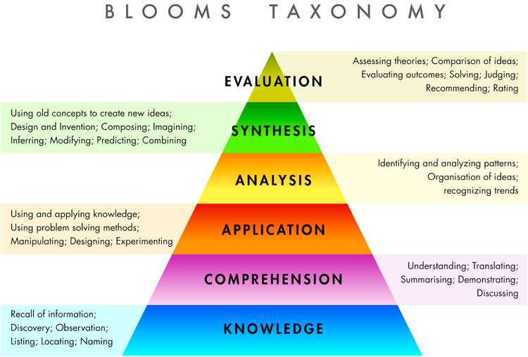

Slide 30
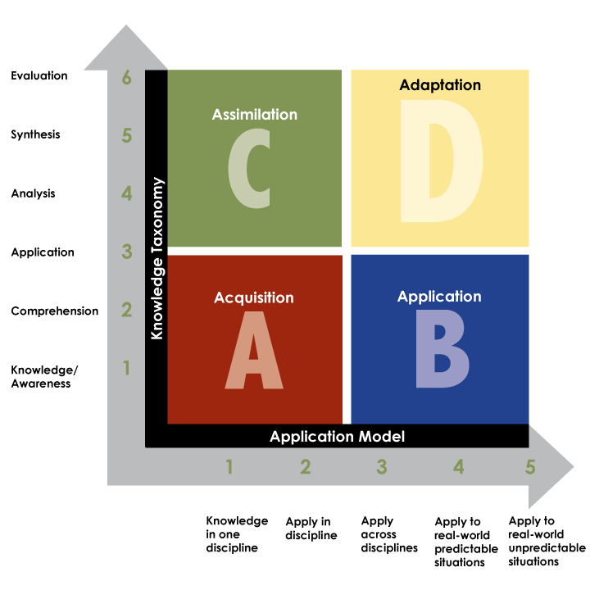
Rigor/Relevance Framework
30
Notes:
Graphic from Bill Daggett’s presentation on Rigor and Relevance.
This is part of the research for the new Model Curriculum Standards. CTE takes the Rigor and Relevance framework and expands it to an even greater degree.

Slide 31
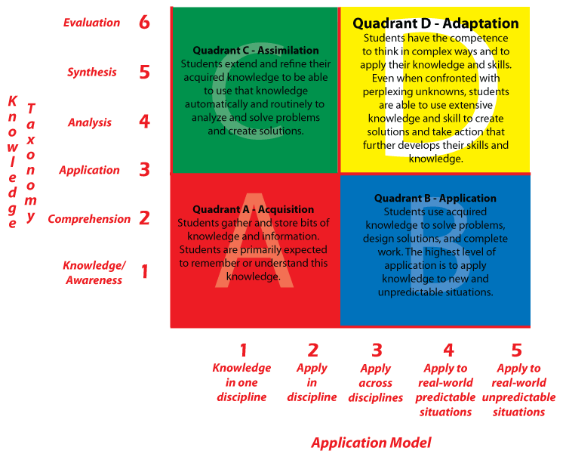

Slide 32
Verbs
Factual Conceptual Procedural Metacognitive
Access Adhere Analyze Advocate
Define Apply Assess Build
Describe Classify Comply Compile
Find Communicate Compare Compose
Identify Compare Contrast Construct
Label Demonstrate Deconstruct Create
List Develop Deduce Design
Locate Discriminate Defend Devise
Match Employ Detect Formulate
Name Explain Diagram Invent
Recall Implement Differentiate Plan
Recite Infer Discern Predict
Recognize Interpret Distinguish Produce
Remember Maintain Enhance Reconstruct
Retrieve Organize Evaluate Reorganize
Select Participate Experiment Synthesize
State Practice Explore
Promote Illustrate
Summarize Integrate
Transfer Research
Understand Solve
Use Test
32
Notes:
These verbs align with the bottom axis on the beyond knowledge construct. These verbs were used when writing the standards to show the progression from lower level to higher level application. These verbs will also be helpful for teachers when they write their lessons using these standards.

Slide 33
Beyond Knowledge Construct
Knowledge
Metacognitive
form a coherent whole
(DOK Level 4)
Procedural
how parts relate, find
Coherence
(DOK Level 3)
Conceptual
clarify, give examples
(DOK Level 2)
List the materials needed to make an A Line Skirt
Factual
recognize, recall, locate
(DOK Level 1)
Performance
Use
one-step process to solve routine problems
Apply
multiple step process to solve routine problems
Solve
non-routine problems using a sequence of steps
Create
solutions to non-routine real world complex problems using multiple steps and sources
Notes:
What Are Depth of Knowledge (DOK )Levels?
The DOK level describes the kind of thinking involved in the task, not whether it will be completed correctly. A greater DOK level requires greater conceptual understanding and cognitive processing by the students. Therefore, on average, students who reach greater DOK levels more regularly will have increased student achievement.
Level 1 involves recall and the response is automatic. Students either know the answer or not. Level 1 activities require students to demonstrate a rote response, follow a set of procedures, or perform simple calculations.
Such as, list 15 building products and find a “green” alternative to each one. - Current CST - California Standards Test

Slide 34
Beyond Knowledge Construct
Knowledge
Metacognitive
form a coherent whole
(DOK Level 4)
Procedural
how parts relate, find
Coherence
(DOK Level 3)
Draw a representation of the A Line Skirt using photographs to represent the textiles you would use for the project.
Conceptual
clarify, give examples
(DOK Level 2)
List the materials needed to make an A Line Skirt
Factual
recognize, recall, locate
(DOK Level 1)
Performance
Use
one-step process to solve routine problems
Apply
multiple step process to solve routine problems
Solve
non-routine problems using a sequence of steps
Create
solutions to non-routine real world complex problems using multiple steps and sources
Notes:
Level 2 activities are more complex and require students to engage in mental processing and reasoning beyond a habitual response. These activities make students decide how to approach the problem, involving interpreting and developing relationships among concepts.
Such as, construct a 1/8th scale model of a garage using only recycled materials.

Slide 35
Beyond Knowledge Construct
Knowledge
Explain the advantages and disadvantages of organic natural fibers for garment construction.
Metacognitive
form a coherent whole
(DOK Level 4)
Procedural
how parts relate, find
Coherence
(DOK Level 3)
Draw a representation of the A Line Skirt using photographs to represent the textiles you would use for the project.
Conceptual
clarify, give examples
(DOK Level 2)
List the materials needed to make an A Line Skirt
Factual
recognize, recall, locate
(DOK Level 1)
Performance
Use
one-step process to solve routine problems
Apply
multiple step process to solve routine problems
Solve
non-routine problems using a sequence of steps
Create
solutions to non-routine real world complex problems using multiple steps and sources
Notes:
Level 3 activities necessitate higher cognitive demands than the previous two levels. At Level 3 students are providing evidentiary support and reasoning for conclusions they draw. In most instances, having students explain and justify their thinking is at a Level 3. Typically, Level 3 activities have more than one correct response or approach to the problem.
Such as, explain the advantages and disadvantages of using recycled building materials.

Slide 36
Beyond Knowledge Construct
Knowledge
Explain the advantages and disadvantages of using building recycled materials
Develop a dress line using only organically grown natural fibers or recycled materials that you will enter into the C.R.E.
Metacognitive
form a coherent whole
(DOK Level 4)
Procedural
how parts relate, find
Coherence
(DOK Level 3)
Conceptual
clarify, give examples
(DOK Level 2)
List 15 building products and a “green” alternative to each
Construct a 1/8th scale model of a garage using only recycled materials
Factual
recognize, recall, locate
(DOK Level 1)
Performance
Use
one-step process to solve routine problems
Apply
multiple step process to solve routine problems
Solve
non-routine problems using a sequence of steps
Create
solutions to non-routine real world complex problems using multiple steps and sources
Notes:
Level 4 includes those tasks in which students must demonstrate reasoning, planning, and developing connections within and beyond a content area. The new Smarter Balanced assessments will include questions from the higher levels of Depth of Knowledge. These tasks should be incorporated into the curriculum since it is this type of thinking we want to encourage from all of our students.
Such as, develop a wind-resistant solar carport for student parking lots and convince the school board to fund it.
The new Smarter Balanced Assessment will be level 3 & 4 questions.
Now that we have explored the major new features and research underlying the new CTE Model Curriculum Standards how does it integrate with the Common Core State Standards?

Slide 37
Beyond Knowledge Construct
Knowledge
Metacognitive
form a coherent whole
(DOK Level 4)
Procedural
how parts relate, find
Coherence
(DOK Level 3)
Conceptual
clarify, give examples
(DOK Level 2)
List five basic ingredients in a baking product.
Factual
recognize, recall, locate
(DOK Level 1)
Performance
Use
one-step process to solve routine problems
Apply
multiple step process to solve routine problems
Solve
non-routine problems using a sequence of steps
Create
solutions to non-routine real world complex problems using multiple steps and sources
Notes:
What Are Depth of Knowledge (DOK )Levels?
The DOK level describes the kind of thinking involved in the task, not whether it will be completed correctly. A greater DOK level requires greater conceptual understanding and cognitive processing by the students. Therefore, on average, students who reach greater DOK levels more regularly will have increased student achievement.
Level 1 involves recall and the response is automatic. Students either know the answer or not. Level 1 activities require students to demonstrate a rote response, follow a set of procedures, or perform simple calculations.
Such as, list 15 building products and find a “green” alternative to each one. - Current CST - California Standards Test

Slide 38
Beyond Knowledge Construct
Knowledge
Metacognitive
form a coherent whole
(DOK Level 4)
Procedural
how parts relate, find
Coherence
(DOK Level 3)
Conceptual
clarify, give examples
(DOK Level 2)
List 5 basic ingredients used in a baking product.
Illustrate each ingredient and find a magazine picture or recipe with that ingredient in it.
Factual
recognize, recall, locate
(DOK Level 1)
Performance
Use
one-step process to solve routine problems
Apply
multiple step process to solve routine problems
Solve
non-routine problems using a sequence of steps
Create
solutions to non-routine real world complex problems using multiple steps and sources
Notes:
Level 2 activities are more complex and require students to engage in mental processing and reasoning beyond a habitual response. These activities make students decide how to approach the problem, involving interpreting and developing relationships among concepts.
Such as, construct a 1/8th scale model of a garage using only recycled materials.

Slide 39
Beyond Knowledge Construct
Knowledge
Metacognitive
form a coherent whole
(DOK Level 4)
Describe the reaction of using to much and too little of each ingredient
Procedural
how parts relate, find
Coherence
(DOK Level 3)
Illustrate each ingredient and find a magazine picture or recipe with that ingredient in it.
Conceptual
clarify, give examples
(DOK Level 2)
List 5 basic ingredients used in a baking product.
Factual
recognize, recall, locate
(DOK Level 1)
Performance
Use
one-step process to solve routine problems
Apply
multiple step process to solve routine problems
Solve
non-routine problems using a sequence of steps
Create
solutions to non-routine real world complex problems using multiple steps and sources
Notes:
Level 3 activities necessitate higher cognitive demands than the previous two levels. At Level 3 students are providing evidentiary support and reasoning for conclusions they draw. In most instances, having students explain and justify their thinking is at a Level 3. Typically, Level 3 activities have more than one correct response or approach to the problem.
Such as, explain the advantages and disadvantages of using recycled building materials.

Slide 40
Beyond Knowledge Construct
Knowledge
Metacognitive
form a coherent whole
(DOK Level 4)
Describe the reaction of using to much and too little of each ingredient
In Kitchen lab make ½ recipe of chocolate chip cookies the correct recipe and ½ recipe with too little or too much of ONE ingredient. Compare results visually and flavor.
Procedural
how parts relate, find
Coherence
(DOK Level 3)
Conceptual
clarify, give examples
(DOK Level 2)
List 5 basic ingredients used in a baking product
Illustrate each ingredient and find a magazine picture or recipe with that ingredient in it.
Factual
recognize, recall, locate
(DOK Level 1)
Performance
Use
one-step process to solve routine problems
Apply
multiple step process to solve routine problems
Solve
non-routine problems using a sequence of steps
Create
solutions to non-routine real world complex problems using multiple steps and sources
Notes:
Level 4 includes those tasks in which students must demonstrate reasoning, planning, and developing connections within and beyond a content area. The new Smarter Balanced assessments will include questions from the higher levels of Depth of Knowledge. These tasks should be incorporated into the curriculum since it is this type of thinking we want to encourage from all of our students.
Such as, develop a wind-resistant solar carport for student parking lots and convince the school board to fund it.
The new Smarter Balanced Assessment will be level 3 & 4 questions.
Now that we have explored the major new features and research underlying the new CTE Model Curriculum Standards how does it integrate with the Common Core State Standards?

Slide 41
Integration with Common Core State Standards
Notes:
Trainer of trainers – the following 6 slides will discuss how the CTE Standards integrate with the Common Core State Standards including the 12 Standards for Career Ready Practice that ALL students (not just CTE students) should know.
The former Foundation standards which are now called the Anchor Standards are common across ALL industry sectors and the Pathway Standards which are specific to each industry.
(See notes under each slide for additional information)

Slide 42
CTE Standards Continuum
Pathway Standards
Industry Sector Anchors
(Knowledge and Performance Anchor Standards)
Standards for Career Ready Practice
Industry Specific
Employer
42
Notes:
The standards for career ready practice are what all high school students need to be employable and college ready.
The industry sector anchor standards (also known in the CDE document as Knowledge and Performance Anchor Standards) are common across the entire industry sector and are what students in that sector need to understand and apply. They are aligned to the ELA common core state standards as all forms of literacy are critical in every industry sector.
The pathway standards are the next level above the anchor and these are specific to a pathway within that industry sector that leads to a student being career ready.
The industry specific standards are standards not covered in our document but are specific to industry that might require certification
An employer may require additional training beyond the industry certificate.

Slide 43
Standards for Career Ready Practice
Apply appropriate technical skills and academic knowledge
Communicate clearly, effectively, and with reason
Develop an education and career plan aligned to personal goals
Apply technology to enhance productivity
Utilize critical thinking to make sense of problems and persevere in solving them
Practice personal health and understand financial literacy
Notes:
Standards for Career Ready Practice: reference pages 11 & 12 of the CTE Model Curriculum Standards Executive Summary.
Cue audience to pull out/ or pass out Handout module 1-#4: Standards for Career Ready Practice
These are for ALL students, not just CTE students!
This is the foundation that all students need to be ready for careers AND college. We will take a closer look at these in Module 2.

Slide 44
Standards for Career Ready Practice (continued)
Act as a responsible citizen in the workplace and the community
Model integrity, ethical leadership, and effective management
Work productively in teams while using cultural/global competence
Demonstrate creativity and innovation
Employ valid and reliable research strategies
Understand the environmental, social, and economic impacts of decisions
Notes:
They are adapted from the National Common Career Technical Core and funded by the National Association of State Directors of CTE Consortium; over 42 states were involved in the development of these practices. This was a national effort to make certain ALL students get this information. These are the updated version of the 21st SCANS skills. Discuss these standards in depth.

Slide 45
HECT Standards Resources
Unwrapping the HECT CTE Standards Resources
http://www.hect.org/workshopstandards.php
Notes:
View the resources and lesson plans online.

Slide 46
Questions or comments?
Thank you for your participation!
Notes:
Ask audience for questions and comments.

